Slide 1

Blockchain Enabled Crowd Funding
Uttam Pandey
Sandeep Sahani
Dhruyash Mahale
Under the guidance of Prof. Sulochana Devi
Copyright @Information Technology Dept , XIE

Slide 2

Introduction
According to experts, there are five key benefits of crowdfunding platforms: efficiency, reach, easier presentation, built-in PR and marketing, and near-immediate validation of concept, which explains why crowdfunding has become an extremely useful alternative to venture capital (VC), and has also allowed non-traditional projects, such as those started by in-need families or hopeful creatives, a new audience to pitch their cause.
To date, $34 billion has been raised through crowdfunding initiatives, adding roughly $65 billion to the global economy in line with projections that show a possible $90 billion valuation for all crowdfunding sources, surpassing venture capital funding in the process.
Copyright @Information Technology Dept , XIE

Slide 3
Problem Statement
In the existing system, the problem is that the companies charge heavily to both the donor and the user. There is no track of the records of the money, transparency, communication between the investor and the user is developing the project. The trust is the main problem when it comes to the crowdfunding with the existing companies. None of these companies provide the donor guarantee policy.
Disadvantages:-
- Not Transparent
High Charges
Donor guarantee policy not available
No track of Records
Copyright @Information Technology Dept , XIE

Slide 4
Objective
In the proposed system, the campaign creators will post their project ideas in the campaign and the interested people will donate the fund to the project idea. Where it defers from the old crowdfunding is that all the money is now digital currencies like ether.
All ether coin will be recorded and keep tracks in the blockchain. Where the blockchain is an immutable ledger. The Donor has control over the funded money. With the Request approval module, the donor has full control over the money they invested.
Only if one by two of the investors need to approve the request made by the creators. By giving control on invested money the Trust is built.
Advantages:-
- Trust
- Control over money
No charges
Donor Guarantee Policy
All transactions are recorded
Money is Stored Securely

Slide 5
Literature Survey
Paper Title | Description
1) Blockchain-enabled smart contracts | The author has provided a detailed explanation of smart contracts and how they have a wide range of possible applications in the digital economy.
2) Venturing crowdfunding using smart contracts in blockchain | Venturing Crowdfunding using Smart Contracts in Block chain they proposed a block chain based crowdfunding application which can give private, secure and decentralized way for crowdfunding.
3) Blockchain based crowdfunding systems | The author has proposed a solution for most common problem around the World including the campaigns are not registered and some of crowd funding campaign are turned out to be fraud. In their project mainly they have focused on smart contract using a Blockchain Technology for preventing fraud and tracking accurate transection record.

Slide 6
Proposed Methodology
As crowd funding contains a lot of transactions, there is a need to handle and document the actions legally.
Therefore, a smart contract is used which is a transaction protocol which automatically execute, control and document actions of the transactions according to the agreement on behalf of project creators and investors.
This project proposes a method which includes two contracts one which stores all the projects and other one which handle the transactions for each project.
In any crowdfunding platform, the main entities are project manager, contributors, vendors, smart contract.

Slide 7
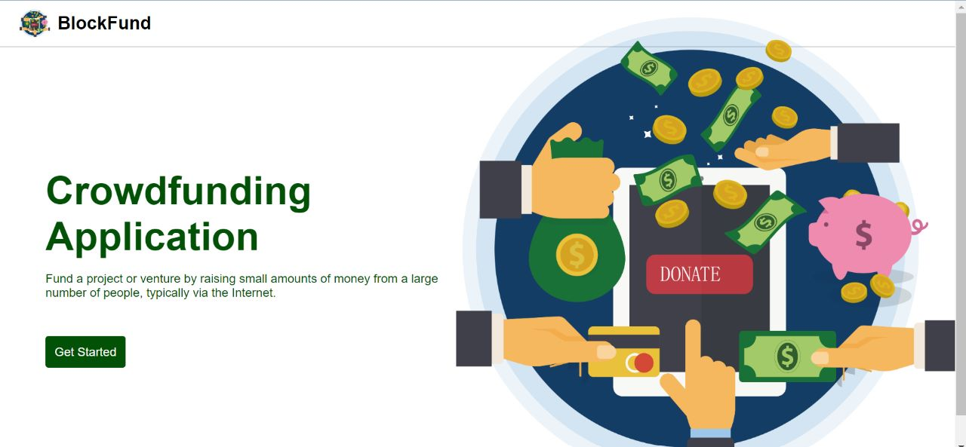
GUI
Front Page:

Slide 8
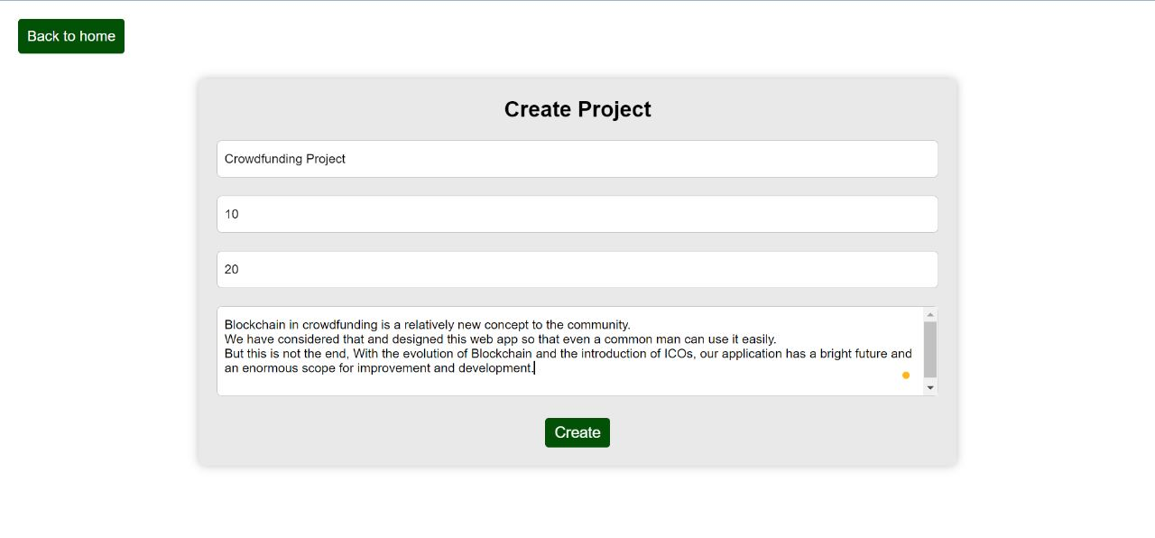
GUI
Ideas:

Slide 9
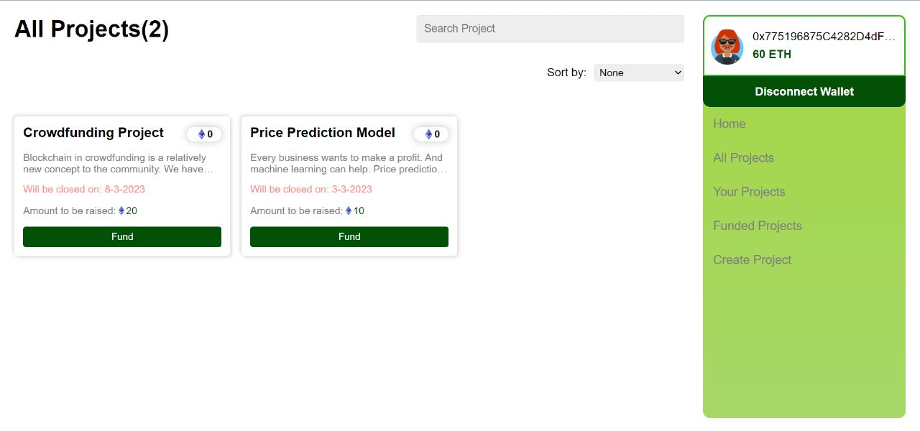
GUI
Ideas:

Slide 10
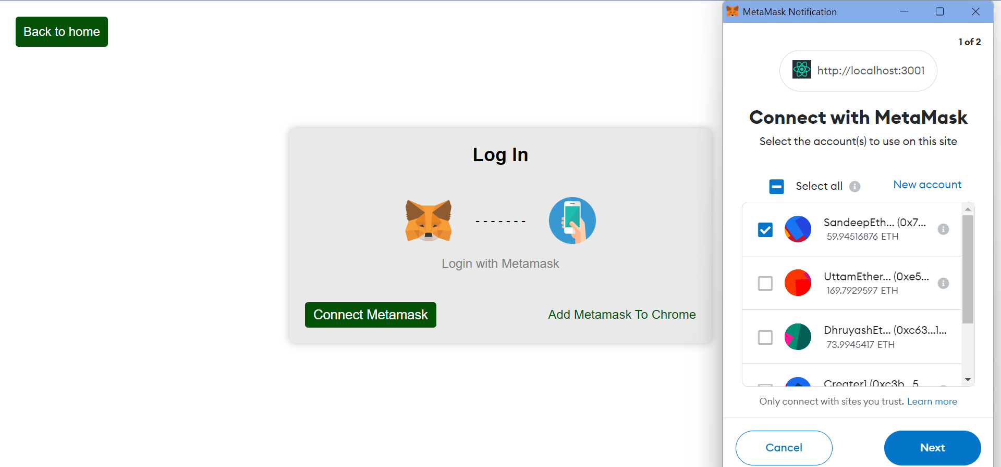
GUI
Login Page:

Slide 11
Requirement Analysis
Backend Requirements
Web3.0
Web3 is a collection of JS libraries that lets you interact with an Ethereum node remotely or locally. Simply, it provides us with an API to use so we can easily work with the blockchain. Web3 works as a wrapper for JSON RPC to connect to a remote or local Ethereum node with either a HTTP or IPC connection. Web3 is basically a connection between the Ethereum blockchain and your smart contract.
2.Solidity
Solidity is an object-oriented programming language created specifically by the Ethereum Network team for constructing and designing smart contracts on Blockchain platforms.
It's used to create smart contracts that implement business logic and generate a chain of transaction records in the blockchain system.
It acts as a tool for creating machine-level code and compiling it on the Ethereum Virtual Machine (EVM).
3.Metamask
MetaMask is a software cryptocurrency wallet used to interact with the Ethereum blockchain. It allows users to access their Ethereum wallet through a browser extension or mobile app, which can then be used to interact with decentralized applications.

Slide 12
Requirement Analysis
Frontend Development
1. HTML
HTML (Hypertext Markup Language) is the code that is used to structure a web page and its content. For example, content could be structured within a set of paragraphs, a list of bulleted points, or using images and data tables.
2. CSS
CSS (Cascading Style Sheets) is used to style and layout web pages — for example, to alter the font, color, size, and spacing of your content, split it into multiple columns, or add animations and other decorative features.
3. Java Script
JavaScript is a scripting language that enables you to create dynamically updating content, control multimedia, animate images, and pretty much everything else.

Slide 13
Conclusion
Blockchain in crowdfunding is a relatively new concept to the community.
We have taken that into consideration and designing this web app so that even a common man can use it with ease.
But this is not the end, With the evolution of Blockchain and introducing of Initial Coin Offering (ICOs), our application has a bright future and a large scope for improvement and evolution.
The world is still adjusting to Blockchain and Cryptocurrencies and it'll take a couple of years more for Ethereum based apps to become popular and to be recognized by the community.
In such a situation Blockchain based crowdfunding application is a tough concept to be understood by everyone. We have taken that into consideration and designed this app so that even a common man can use it with ease. But this is not the end.
With the evolution of Blockchain and introducing of ICOs, our application has a bright future and a large scope for improvement and evolution. In the future, we wish to provide an even easier and safer way for all ideas to get life through our crowdfunding application.
Copyright @Information Technology Dept , XIE

Slide 14
Reference
[1] Wang, Shuai, et al. ”Blockchain-enabled smart contracts: architecture, applications, and future trends.” IEEE Transactions on Systems, Man, and Cybernetics: Systems 49.11 (2019): 2266-2277.
[2] Yadav, Nikhil, and V. Sarasvathi. ”Venturing crowdfunding using smart contracts in blockchain.” 2020 Third International Conference on Smart Systems and Inventive Technology (ICSSIT). IEEE, 2020.
[3] Saadat, M. Nazmus, et al. ”Blockchain based crowdfunding systems.” Indonesian Journal of Electrical Engineering and Computer Science 15.1 (2019): 409-413.
[4] F. Glaser, “Pervasive decentralisation of digital infrastructures: A framework for blockchain enabled system and use case analysis,” in Proc. 50th Hawaii Int. Conf. Syst. Sci., 2017, pp. 1543–1552.
[5] Blockchain Based Crowd funding for Startups Anand Haridas1 Mrudula R2 Bavitha B3 Clincy Baby4 Aswathy M5 1Assistant Professor 2,3,4,5Student 1,2,3,4,5Ahalia School of Engineering and Technology, Kerala, India .
Copyright @Information Technology Dept , XIE

Slide 15
THANK YOU
Copyright @Information Technology Dept , XIE

